Slide 1

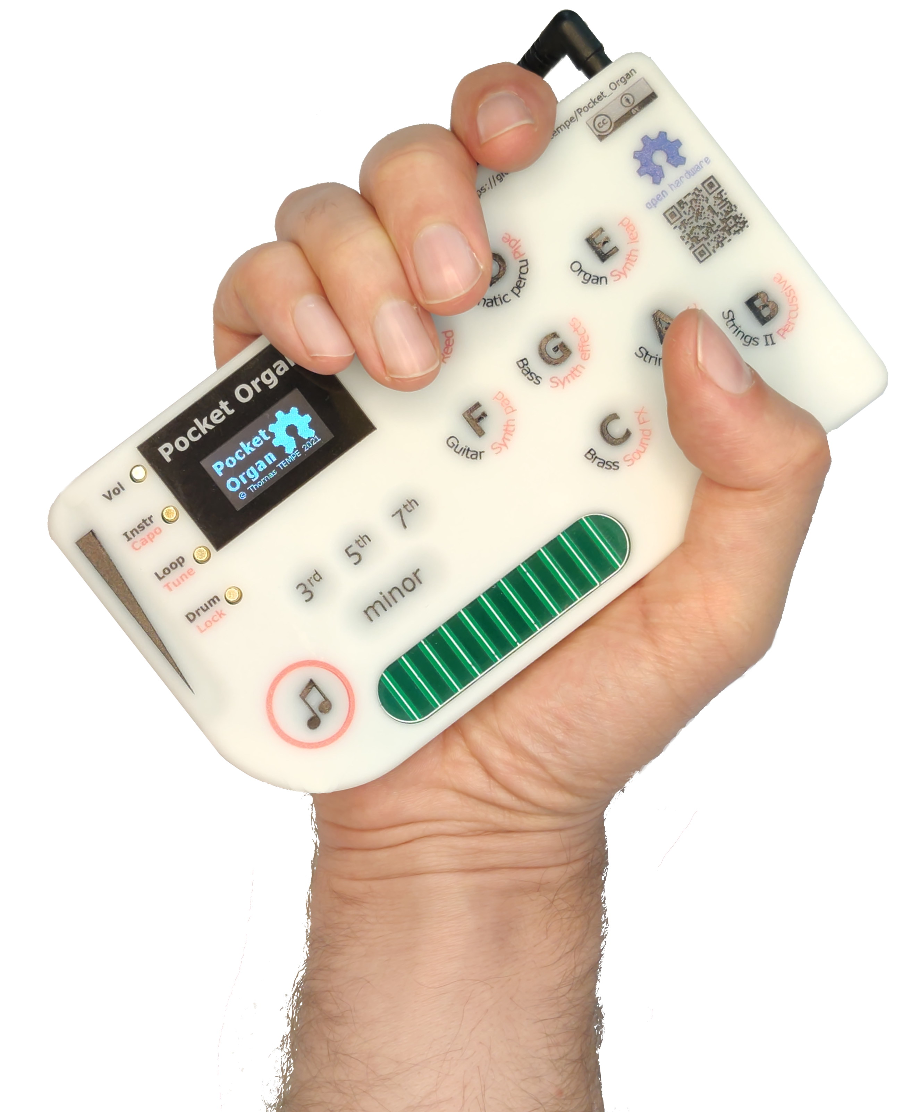
Pocket organ 口袋琴
Very few instruments are actually modern. Most of them have centuries-old user interfaces, constrained by the limits of woodworking and the need to produce sound.
What if we were to design an instrument today? I want mine to fit in my pocket, be easy and fun to learn, and be expressive, cheap, open source, and easily hackable.
实际上当下很少有乐器可以被认为是现代的，受限于几百年前的制作工艺和材料，大部分乐器的用户界面都有着数百年的历史。
如果我们按现代的技术与人体工程设计一款乐器，它会是什么样的？我希望它能轻松地塞在衣服口袋里，易学好用，有充分的表现力，便宜，开源，并且有容易更改的设计代码。
_{Maker: Thomas TEMPE}
_{创客：唐沛}

Slide 2
Musical instruments Desirable attributes 乐器的期望特性

Slide 3
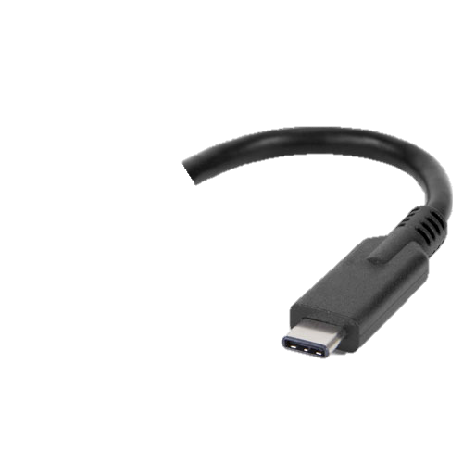
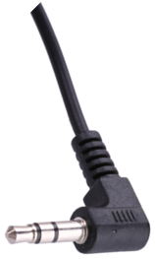
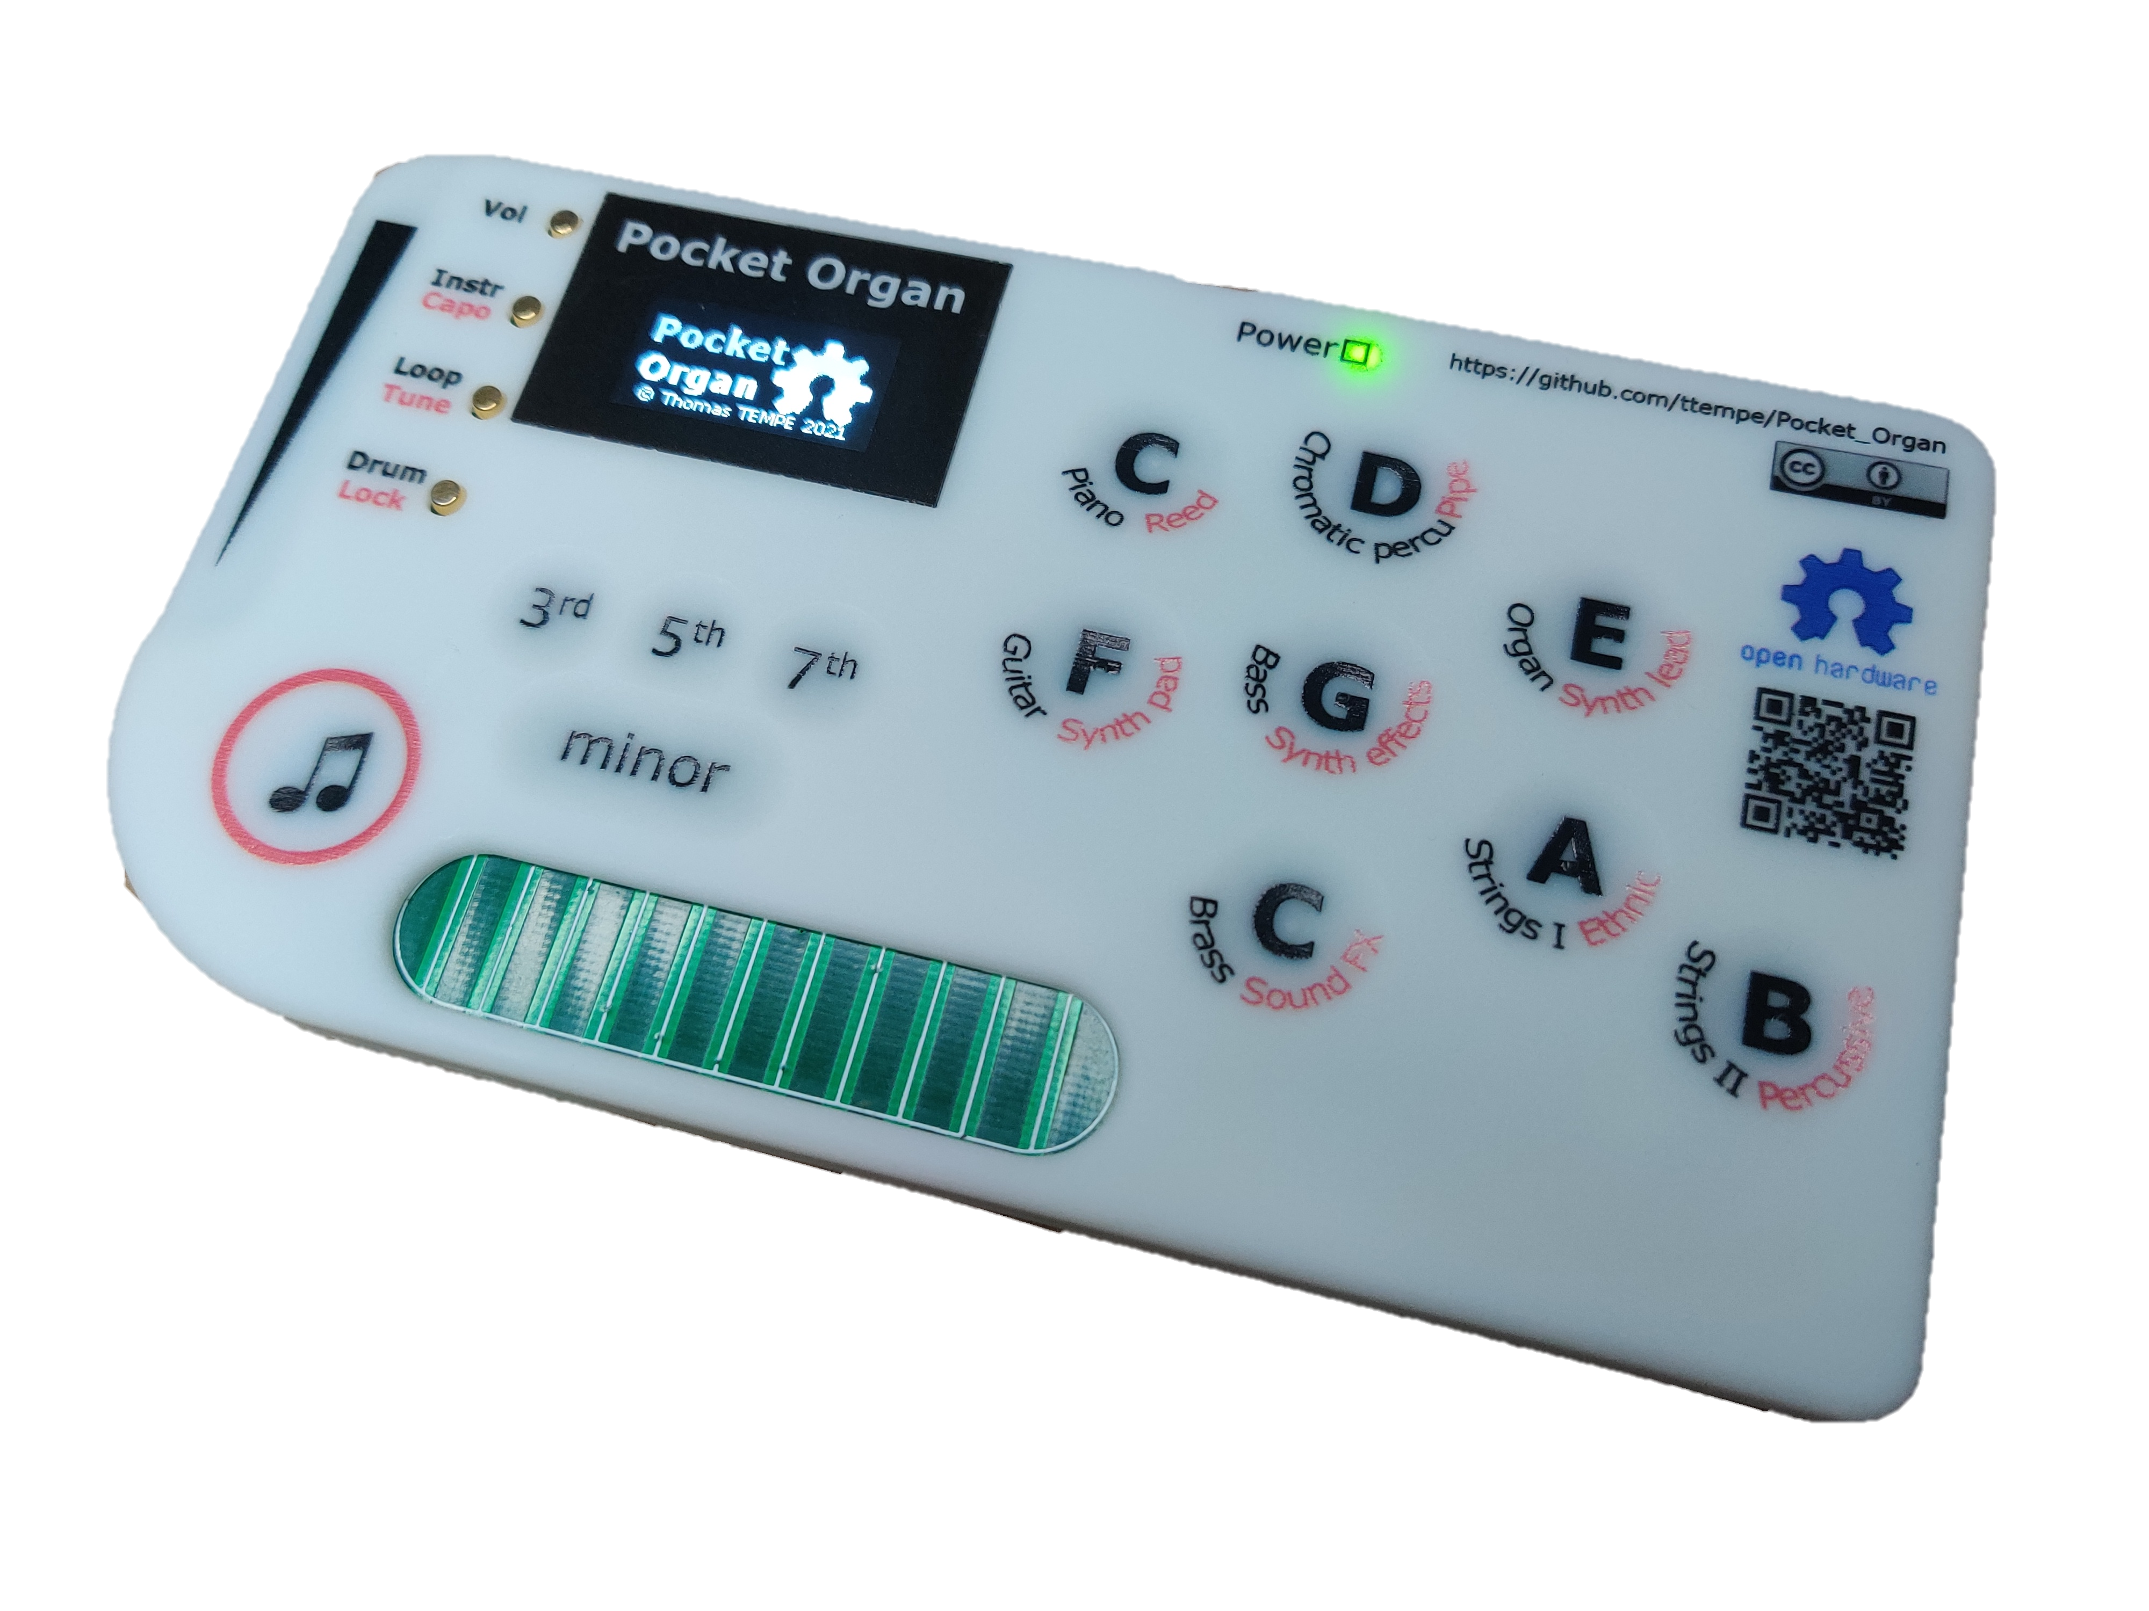
INSTRUMENT LAYOUT 乐器的样子
USB for MIDI & charging
USB充电与MIDI接口
Headphone jack
耳机插座
Display:
Tells you what you’re playing!
屏幕显示您现在演奏什么
Capacitive analog keyboard
压感按键
A selection of chord shapes
多种和弦可选
Strumming comb
弹拨梳

Slide 4
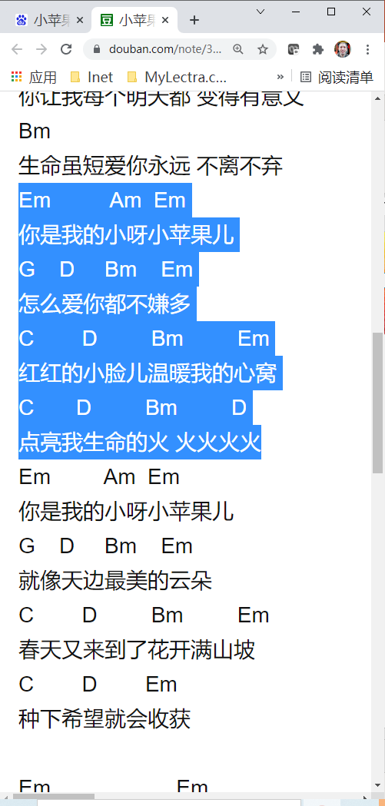
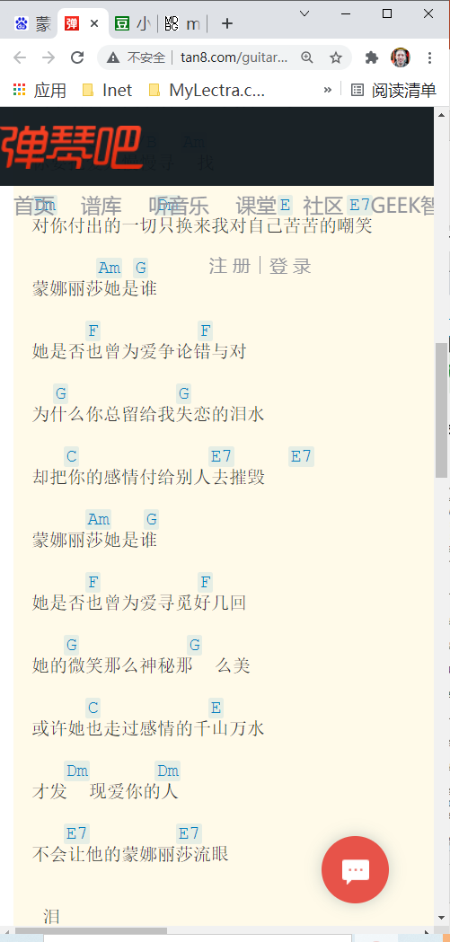


Easily lookup guitar chords 直接搜寻歌曲的 吉他和弦谱

